Slide 1
Volatility clustering and dynamic trading
Seminar: Econometric Models in Financial Applications
Felix Pettersson
30.11.2025

Slide 2
Introduction
Returns often exhibit non-stationarity and volatility clusters
  Can be interpreted as regimes
Regime-switching models are nothing new in the literature (MS-GARCH, HMM, and more)
All have parametric restrictions and require pre-specification of number of regimes
I test a method (or ”framework”) that uses unsupervised learning
  Classification or, more specifically, clustering
Rely on very few assumptions and does not need to know the number of clusters a priori

Slide 3
Agenda
Introduction to change point detection models
Theory: The Wasserstein distance
Theory: Clustering
Results
  Synthetic data
  Real-world data
  Trading algorithm and backtesting

Slide 4
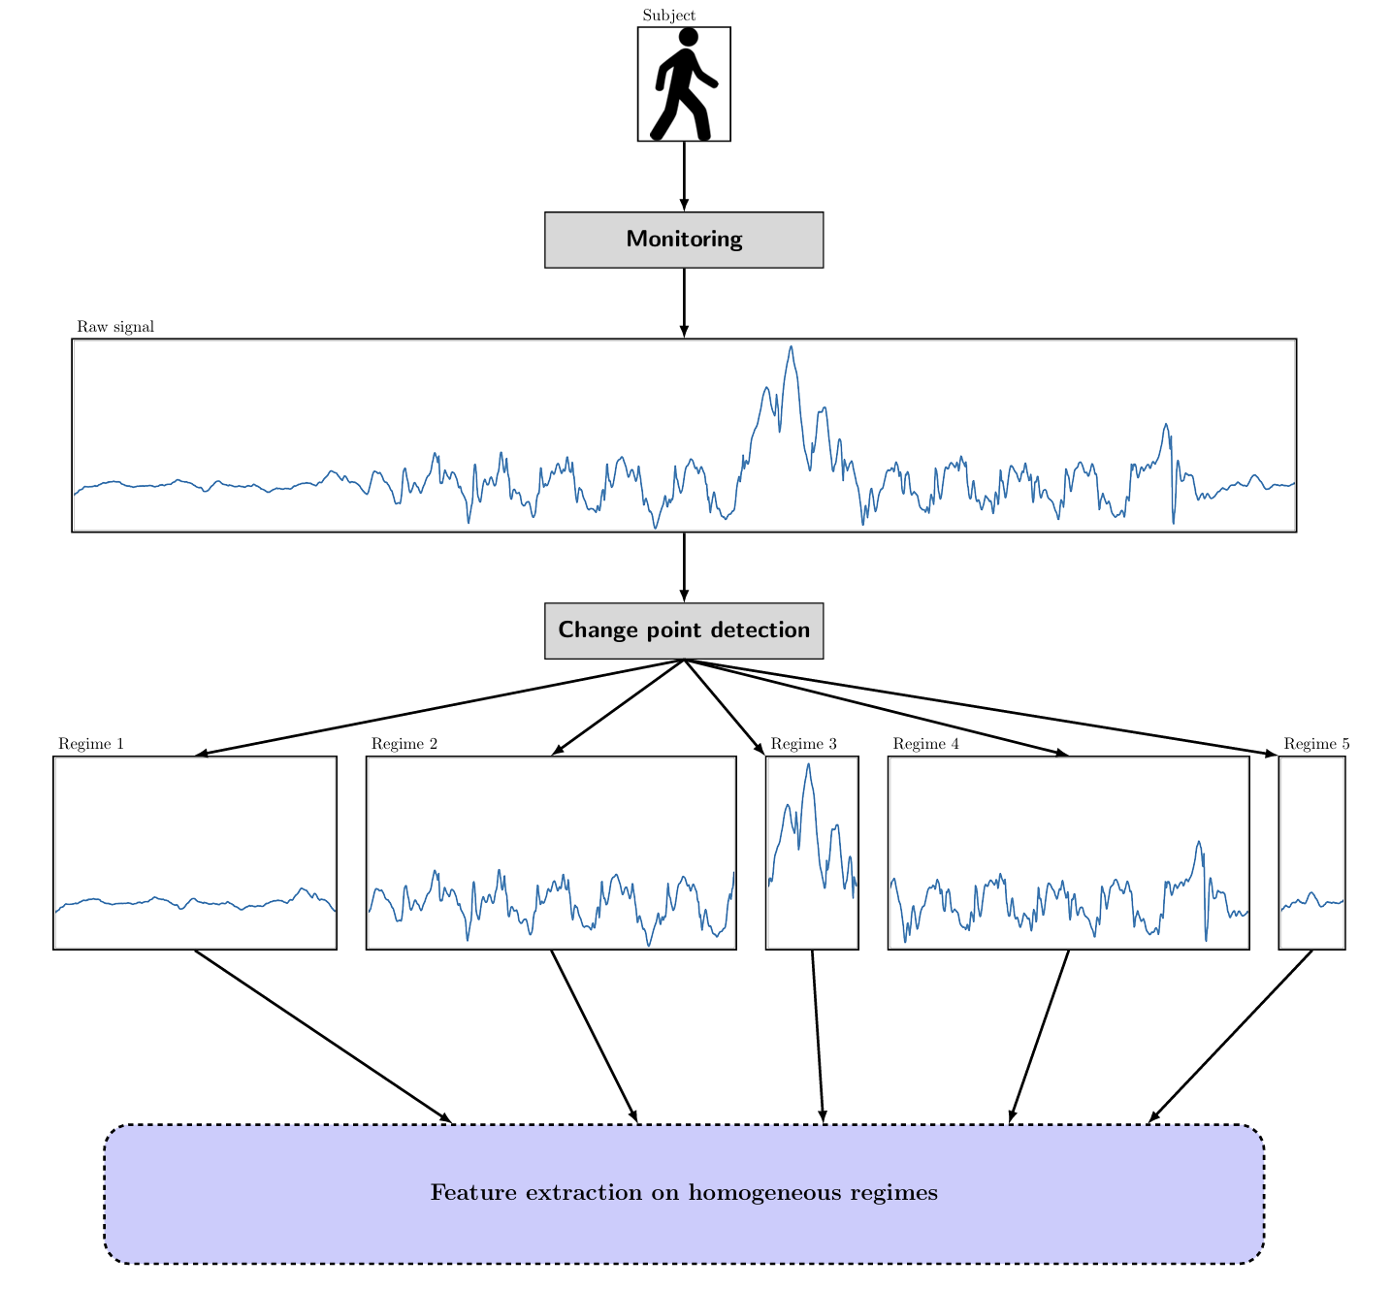
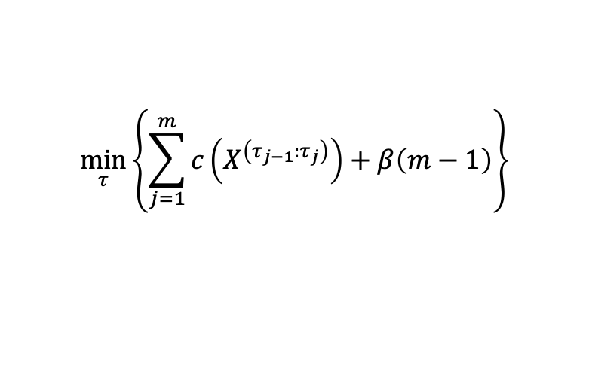


Change point detection – concept and model
Change point aims to segment a time series into locally stationary segments
  Does so through minimizing a cost function
Offline change detection → has to be used in-sample
$$For time series X_{t}$$
$$\min_{τ}\left\{\sum_{j=1}^{m}{c\left(X^{\left(τ_{j−1}:τ_{j}\right)}\right)+β\left(m−1\right)}\right\}$$
$c\left(X^{\left(τ_{j−1}:τ_{j}\right)}\right)=\left(τ_{j−1}−τ_{j}\right)\log{{\hat{σ}}^{2}}$+C

Slide 5
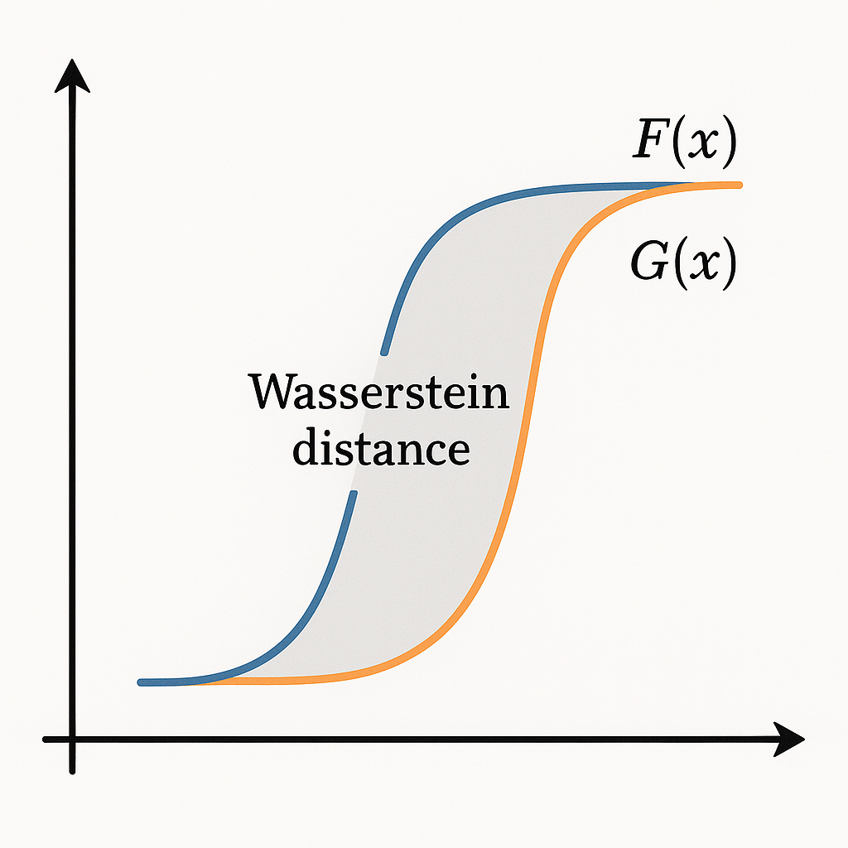
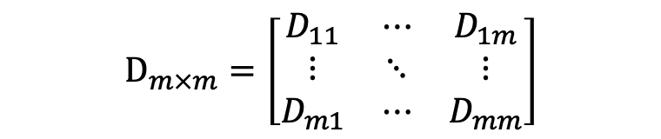
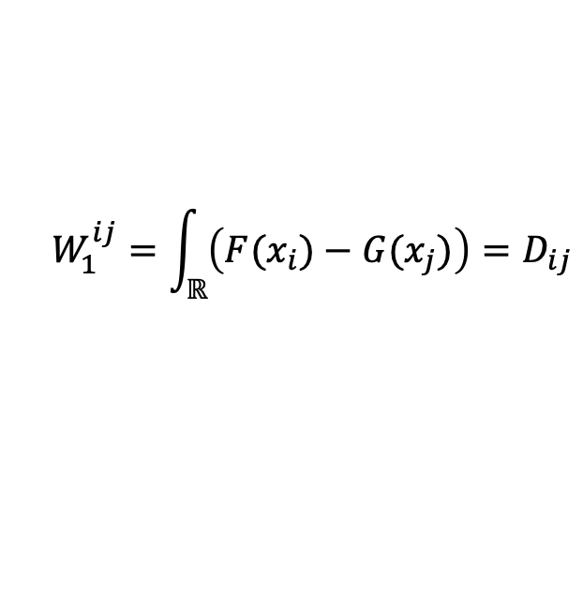

The Wasserstein Distance
The Pairwise Wasserstein Distance
Distance in distribution between two segments
”Difference in mass between two cdfs”
Computed for all possible pairs of m segments
To construct the distance matrix
$$For two segments of X_{t}, x_{i} and{ x}_{j}$$
$$W_{1}^{ij}=\int_{ℝ}{\left(F(x_{i})−G(x_{j})\right)}=D_{ij}$$
$$D_{m×m}=\left[\begin{matrix}D_{11} & ⋯ & D_{1m} \\ ⋮ & ⋱ & ⋮ \\ D_{m1} & ⋯ & D_{mm}\end{matrix}\right]$$

Slide 6



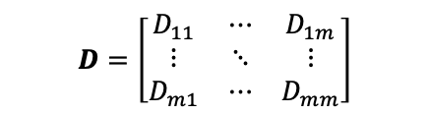
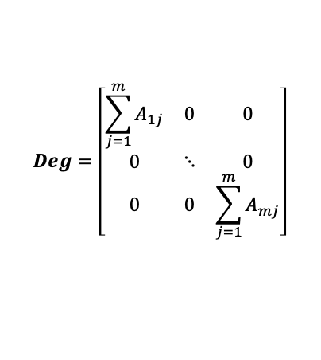
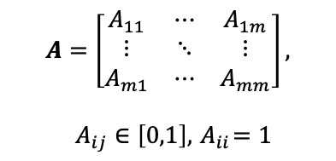
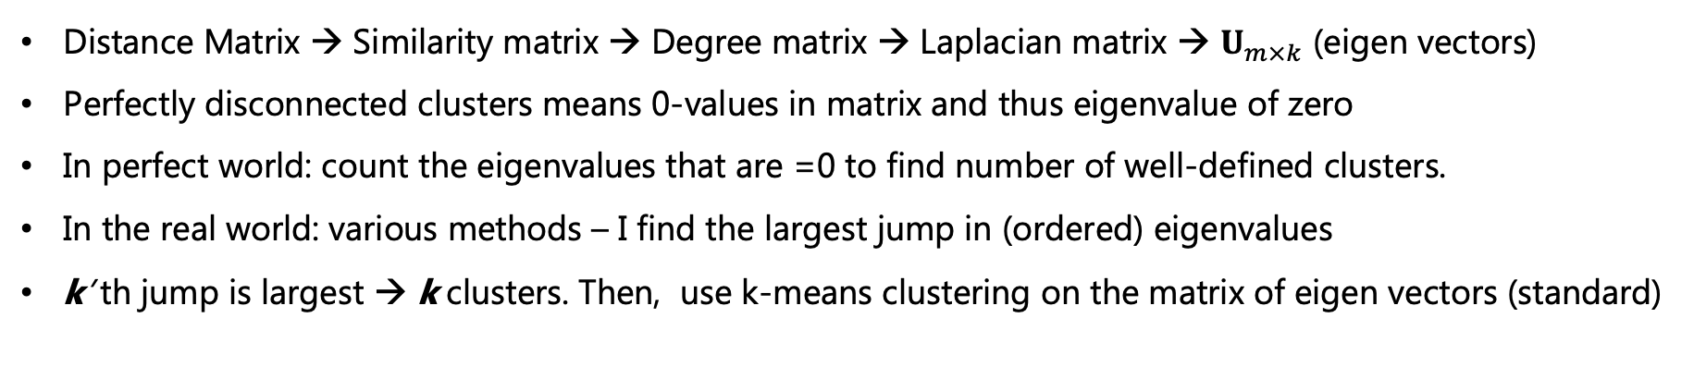
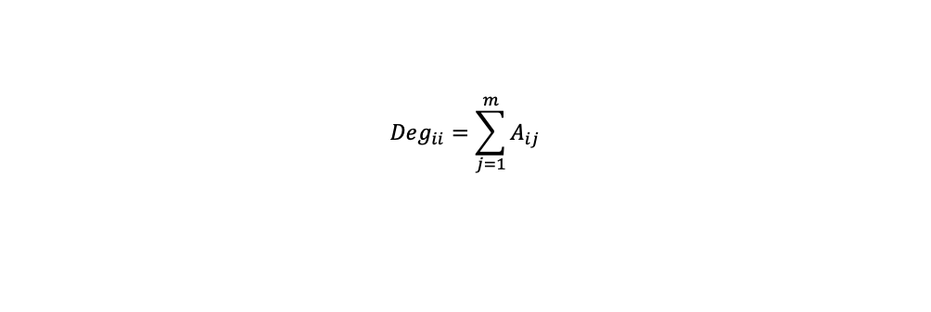
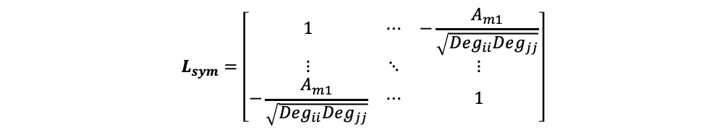
Self-tuning spectral clustering
Distance Matrix → Similarity matrix → Degree matrix → Laplacian matrix → $U_{m×k}$ (eigen vectors)
Perfectly disconnected clusters means 0-values in matrix and thus eigenvalue of zero
In perfect world: count the eigenvalues that are =0 to find number of well-defined clusters.
In the real world: various methods – I find the largest jump in (ordered) eigenvalues
k’ th jump is largest → k clusters. Then, use k-means clustering on the matrix of eigen vectors (standard)
$$A=\left[\begin{matrix}A_{11} & ⋯ & A_{1m} \\ ⋮ & ⋱ & ⋮ \\ A_{m1} & ⋯ & A_{mm}\end{matrix}\right],$$
$$A_{ij}∈\left[0,1\right], { A}_{ii}=1$$
$$Deg=\left[\begin{matrix}\sum_{j=1}^{m}{A_{1j}} & 0 & 0 \\ 0 & ⋱ & 0 \\ 0 & 0 & \sum_{j=1}^{m}{A_{mj}}\end{matrix}\right]$$
$$L_{sym}=\left[\begin{matrix}1 & ⋯ & −\frac{A_{m1}}{\sqrt{Deg_{ii}Deg_{jj}}} \\ ⋮ & ⋱ & ⋮ \\ −\frac{A_{m1}}{\sqrt{Deg_{ii}Deg_{jj}}} & ⋯ & 1\end{matrix}\right]$$
$$D=\left[\begin{matrix}D_{11} & ⋯ & D_{1m} \\ ⋮ & ⋱ & ⋮ \\ D_{m1} & ⋯ & D_{mm}\end{matrix}\right]$$
$$Deg_{ii}=\sum_{j=1}^{m}{A_{ij}}$$
$$A_{ij}=\exp\left(−\frac{D_{ij}^{2}}{σ_{i}σ_{j}}\right)=\exp\left(−\frac{D_{ij}^{2}}{D_{i,K }D_{j,K } }\right)$$
$$L=Deg−A$$
$$L_{sym}=Deg^{−\frac{1}{2}}LDeg^{−\frac{1}{2}}$$

Slide 7
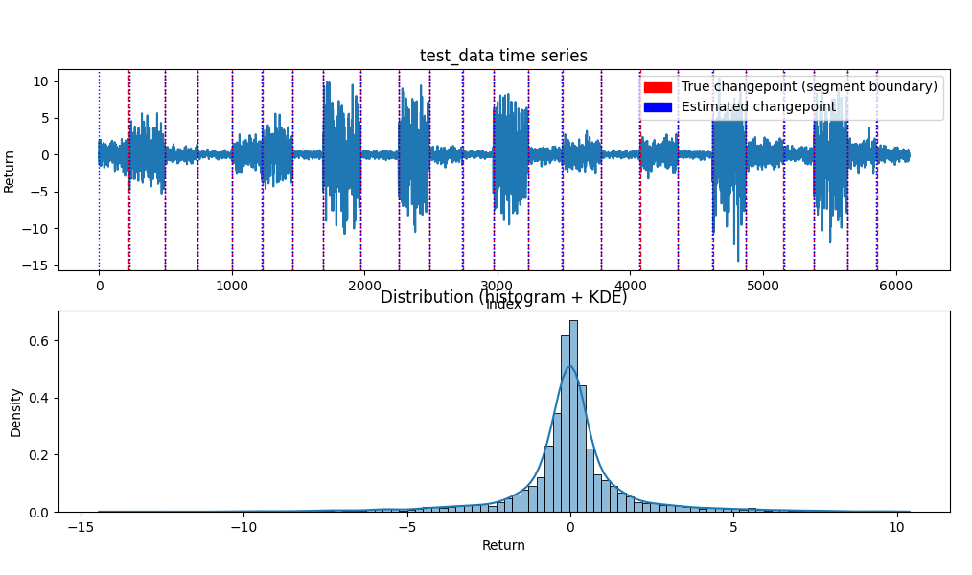
Results – synthetic data (1/2)

Slide 8
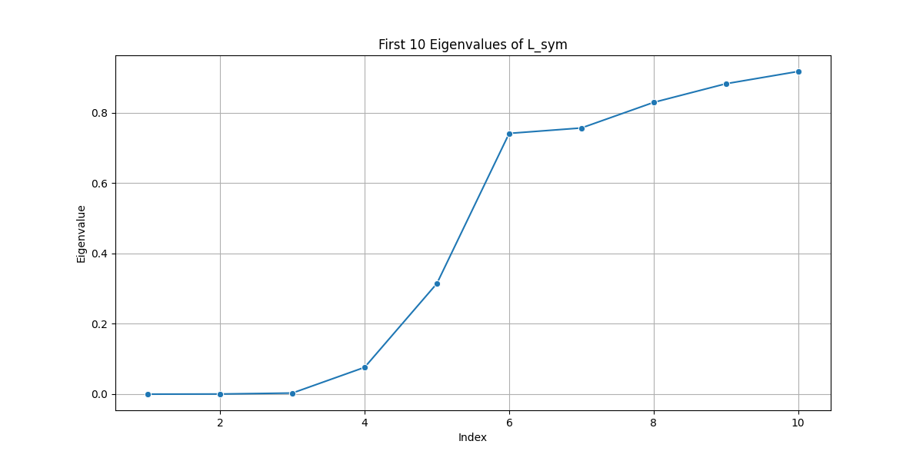
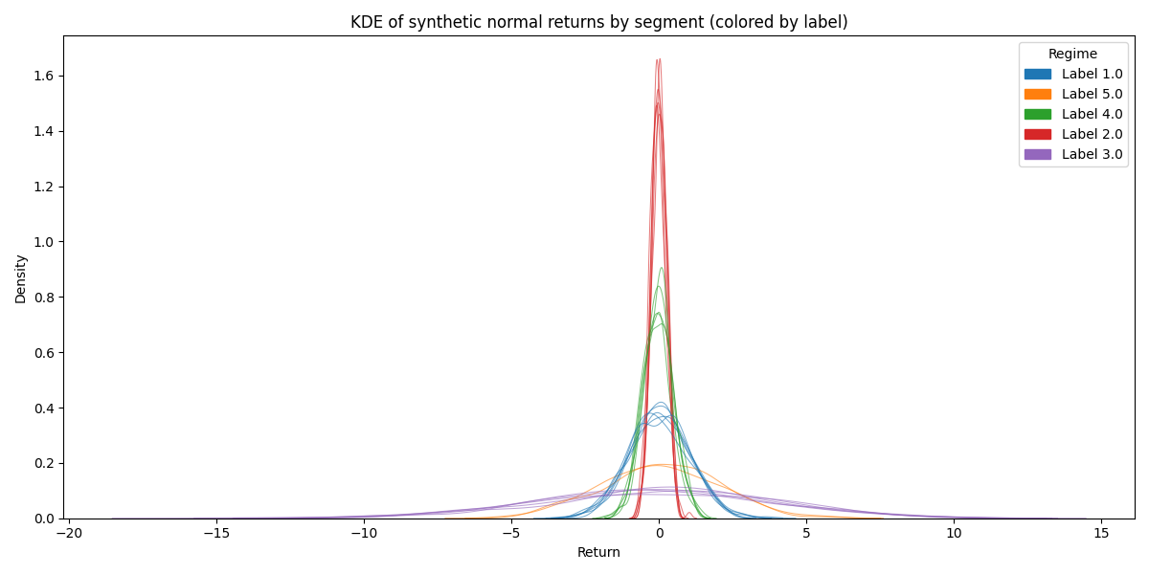
Results – synthetic data (2/2)
1 of 100 iterations of data with segments of normally distributed data
Largest jump in eigenvalue = 5 → 5 clusters

Slide 9
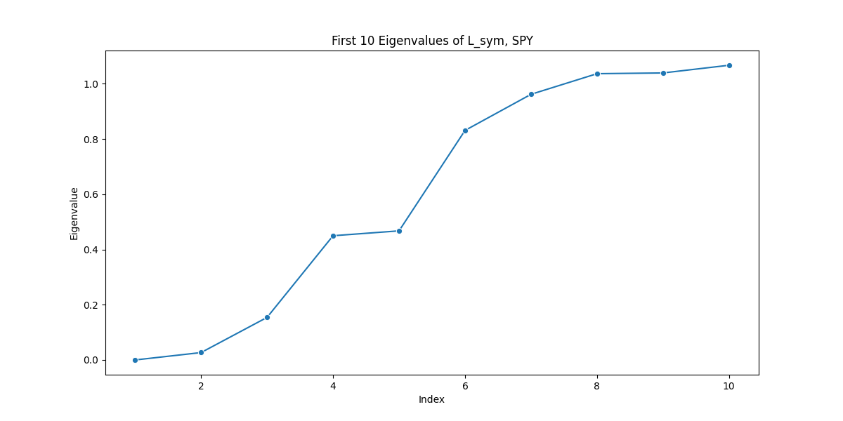
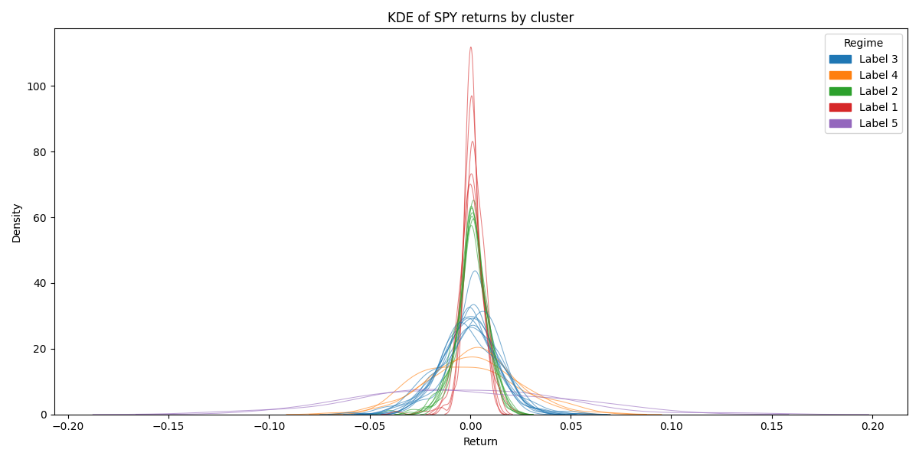
Results – real-world data (1/2)
Six assets: SP500, NASDAQ, Gold, US Real Estate ETF, US 20-year T-bond ETF, Emerging Markets ETF
Here: SP500
Largest jump in eigenvalue = 5 → 5 clusters

Slide 10
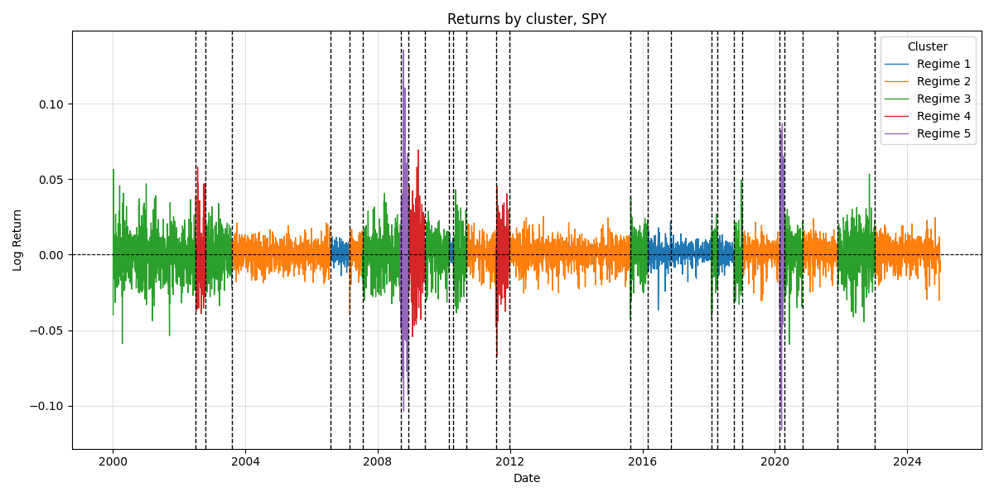
Results – real-world data (2/2)
One could stop here…

Slide 11
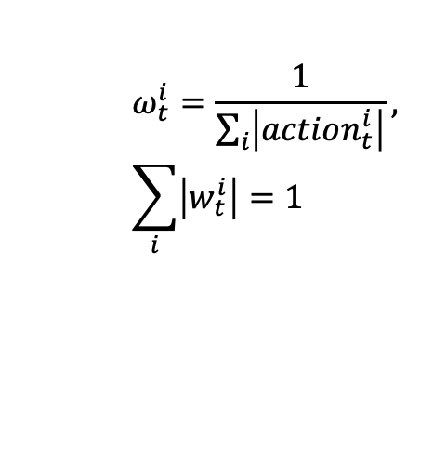
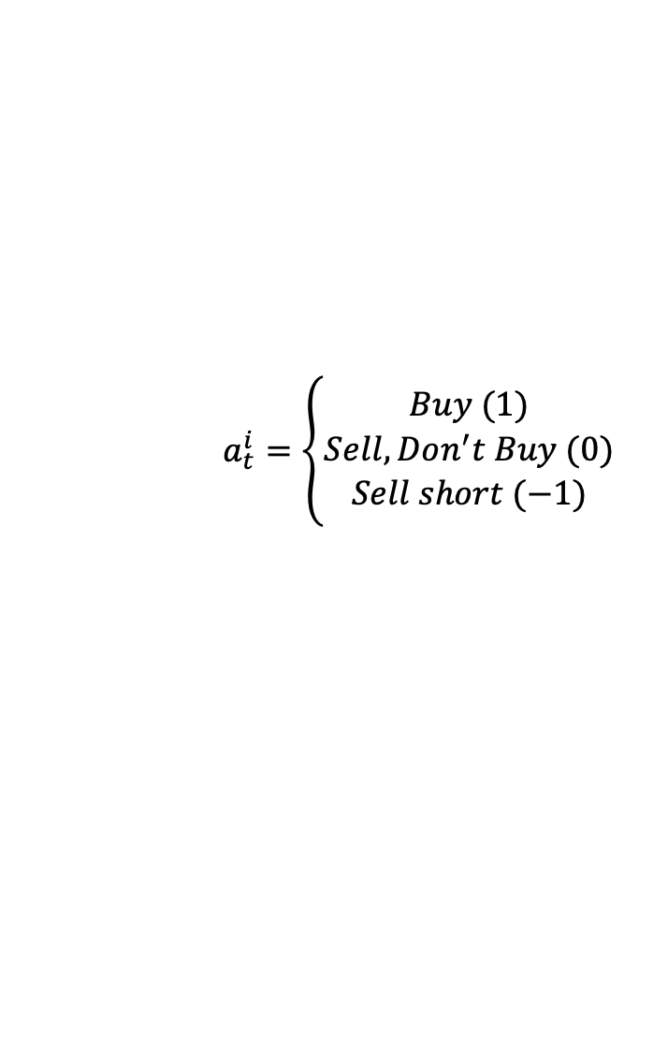
Trading strategy and backtesting (algorithm)
10-year in-sample clustering → Historic regimes
From t=0:
  Every 20 days: match current (last 20 days) probability distribution to most similar historic regime → Current regime
  Collect the actions of all assets
  Compute the resulting weights
  Repeat every 20 days
Historic Returns | Regime 1 | Regime 2 | Regime 3
Asset 1 | +2% | +1% | -5%
Asset 2 | -5% | 0% | +3%
Asset…
$$a_{t}^{i}=\left\{\begin{aligned}Buy (1) \\ Sell, Don^{′}t Buy (0) \\ Sell short (−1)\end{aligned}\right.$$
$$ω_{t}^{i}=\frac{1}{\sum_{i}{\left|action_{t}^{i}\right|}}, \sum_{i}{\left|w_{t}^{i}\right|=1}$$

Slide 12
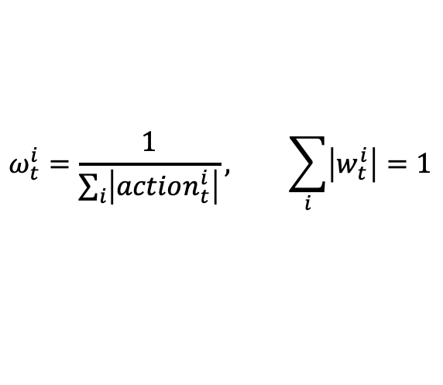
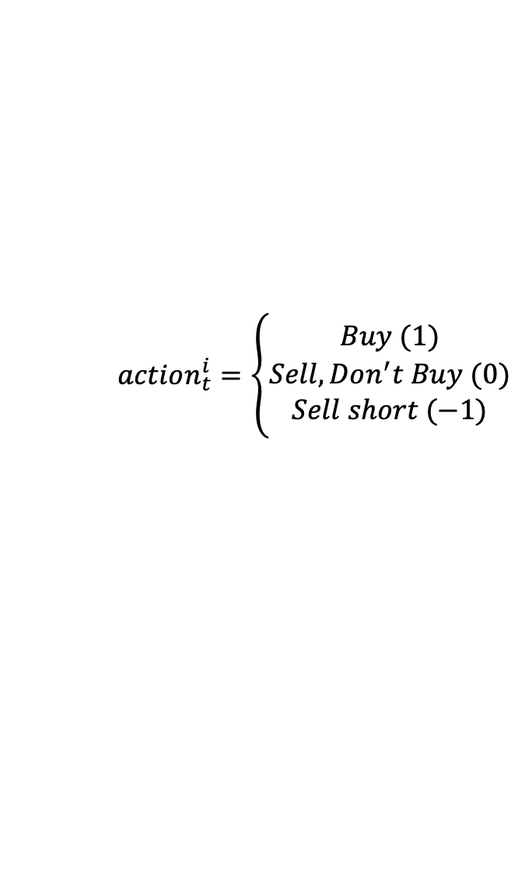

Trading strategy and backtesting (algorithm)
Historic Returns | Regime 1 | Regime 2 | Regime 3
Asset 1 | +2% | +1% | -5%
Asset2 | -5% | 0% | +3%
Current regime, t₁
Current regime, t₂
20-day lookback
10-year in-sample clustering
$$min{ W}_{1}$$
10-year lookback
$$action_{t}^{i}=\left\{\begin{aligned}Buy (1) \\ Sell, Don^{′}t Buy (0) \\ Sell short (−1)\end{aligned}\right.$$
…
Updated 10-year lookback
$$ω_{t}^{i}=\frac{1}{\sum_{i}{\left|action_{t}^{i}\right|}}, \sum_{i}{\left|w_{t}^{i}\right|=1}$$

Slide 13
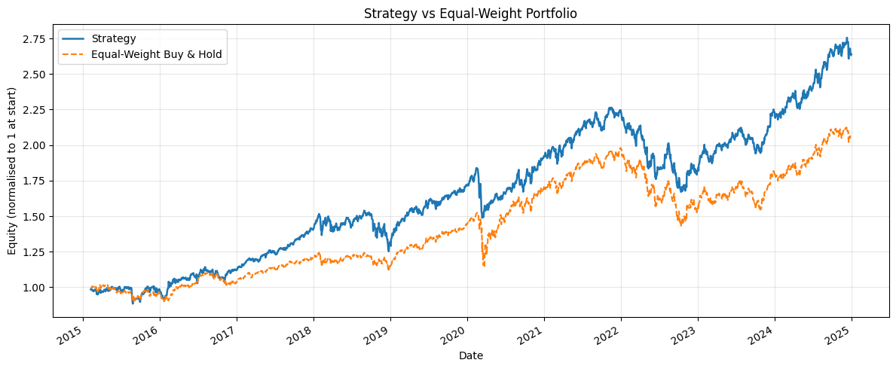
Trading strategy and backtesting (preliminary results)

Slide 14
Questions?

